Slide 1

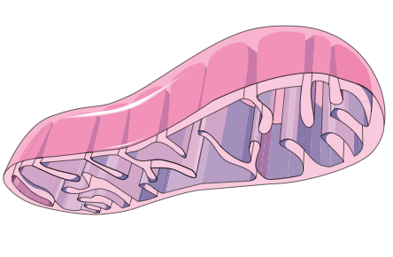
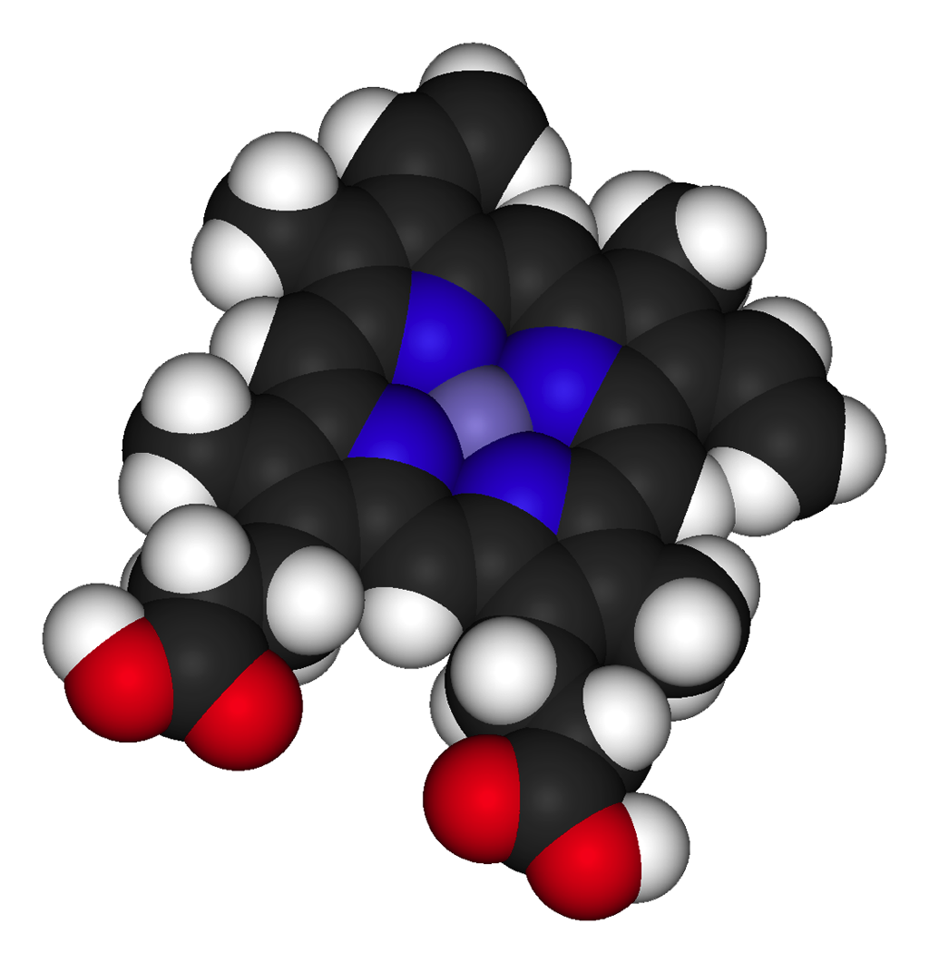
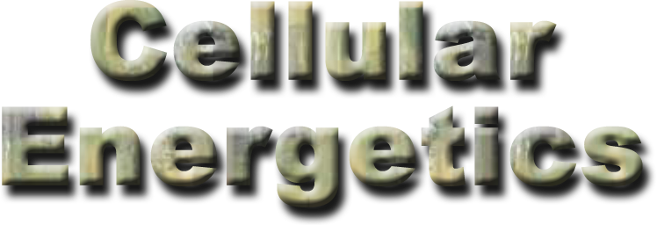
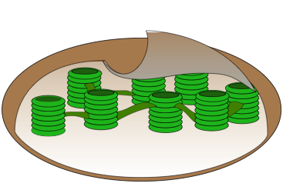
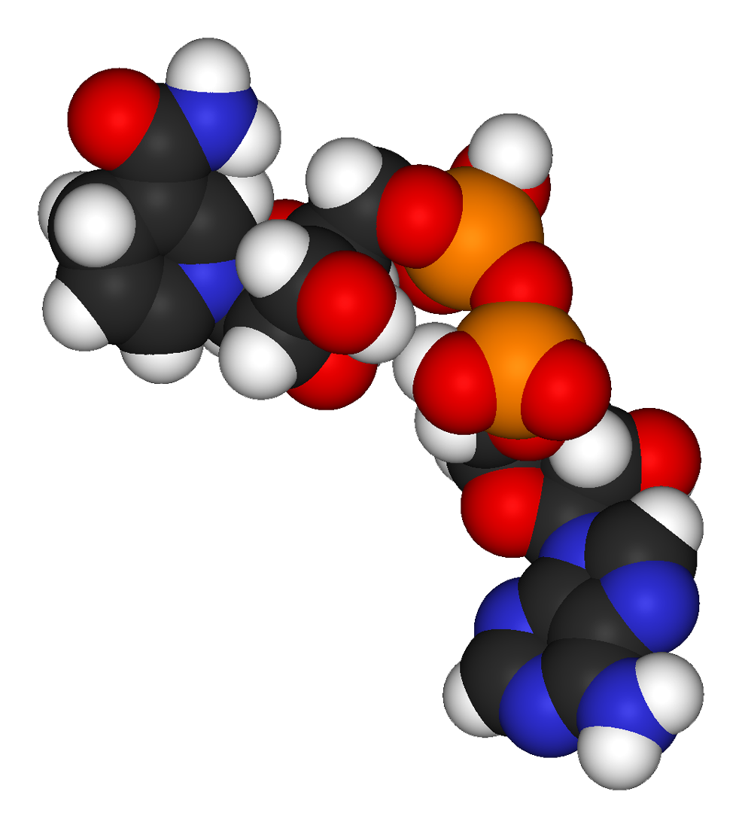

Cell Biology & Biochemistry Series:
Set 5
Version: 1.0

Slide 2
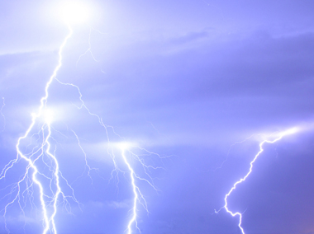
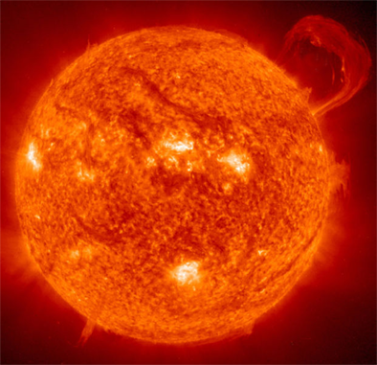
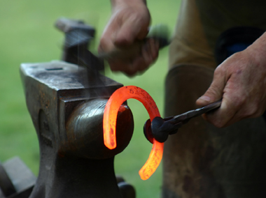
Energy
Lightning (electrical energy)
All organisms require energy to grow, reproduce, move and carry out fundamental maintenance and repairs.
Energy can not be created or destroyed, but it can be converted from one form to another.
The ultimate source of energy is the sun.
The Sun is the ultimate energy source for life on Earth
Heat (thermal energy)
Photo credit: NASA

Slide 3
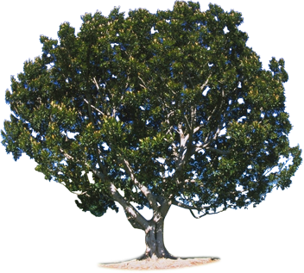
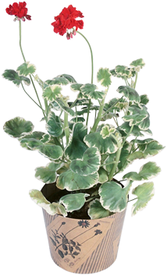
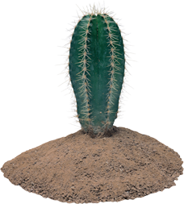
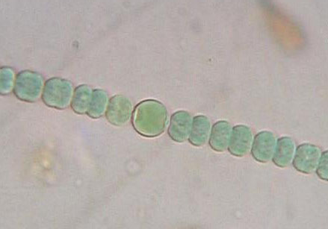
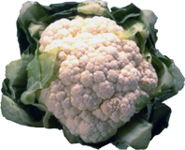
Energy Producers
Most plants are autotrophs.
Organisms which are capable of producing their own energy are called autotrophs.
Photosynthetic autotrophs (e.g. plants, algae and some bacteria) convert light energy into chemical energy.
Chemosynthetic autotrophs derive
their energy from inorganic sources such as sulfur or ammonia. Some bacteria
are chemoautotrophs.
Anabaena sphaerica (left) is a cyanobacterium, and is an example of an autotrophic bacteria.

Slide 4
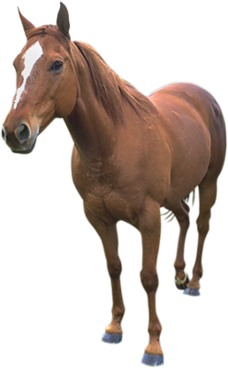
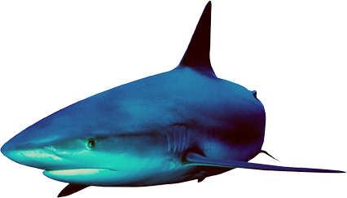
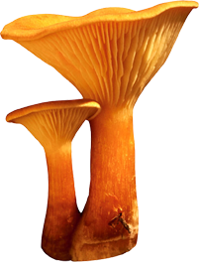
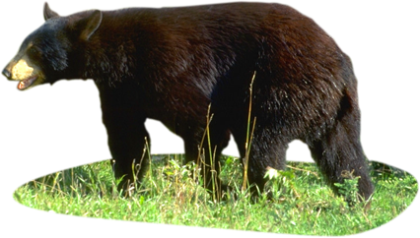
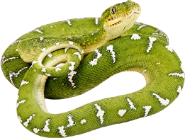
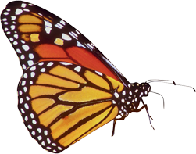
Energy Consumers
Heterotrophs are organisms which cannot make their own energy. All animals, fungi and some bacteria are heterotrophs.
Chemosynthetic heterotrophs consume
other organisms to obtain their
energy and carbon sources.
Photosynthetic heterotrophs are
able to convert light energy, but still require organic compounds as a carbon source.
Some bacteria are photoheterotrophs.

Slide 5
Energy in Cells
Carbon dioxide + water
Light energy
Oxygen
Oxygen
A summary of the energy flow within a plant cell is shown here. In animal cells the glucose* is supplied by feeding, not photosynthesis.
Energy not immediately stored in chemical bonds is lost as heat.
ATP provides the energy for metabolic reactions, including photosynthesis.
Photosynthesis
Other uses of glucose
Glucose*
ADP
Fuel
Respiration
ATP
Water
Heat energy
Carbon dioxide

Slide 6
ATP Structure
Adenosine triphosphate (ATP) is the universal energy carrier for cells.
ATP is classed as a nucleotide and is composed of adenine, ribose and three phosphate groups.
Covalent bonds join the two terminal phosphate groups to the nucleotide.
A
Adenine
Phosphates
A symbolic form of
ATP (adenosine triphosphate)
Ribose

Slide 7
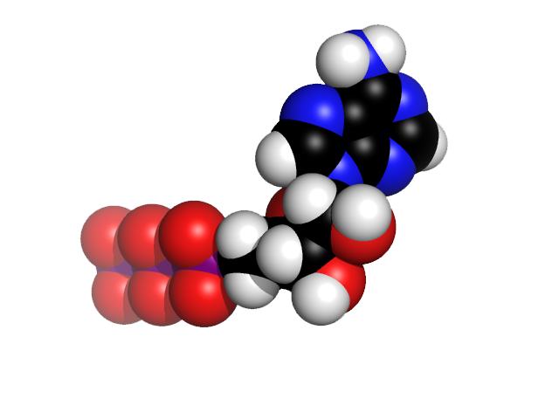
ATP Structure
NH2
Adenine
C
C
N
Phosphate groups
N
C
H
H
C
C
N
N
O⁻
O⁻
O⁻
Adenine
O⁻
P
O
P
O
P
O
CH2
O
H
H
O
O
O
H
H
OH
OH
Ribose
The chemical structure of adenosine triphosphate (ATP), and a space filling molecule (right).
Phosphate groups
Ribose

Slide 8

The Role of ATP in Cells
ATP
ATP can release its energy quickly by hydrolysis of the terminal phosphate.
  This reaction is catalyzed by the enzyme ATPase.
Once ATP has released its energy, it becomes ADP (adenosine diphosphate).
  ADP is a low energy molecule that can be recharged by adding a phosphate.
ATPase
Pi
Inorganic
phosphate
P
ADP +

Slide 9
The Role of ATP in Cells
The energy released from the loss of a phosphate is available for immediate work inside the cell.
P
A free phosphate is released from the ATP. This may be reused to regenerate ATP from ADP again.
ATPase
Adenosine
triphosphate ATP
A high energy compound able to supply energy for metabolic activity.
Adenosine
diphosphate ADP
A low energy compound with no available energy to fuel metabolic activity.
In cellular respiration, glucose is oxidized in a step-wise process that provides the energy to make high energy ATP from ADP.
Apart from glycolysis, these processes occur in the mitochondria.
Pi

Slide 10
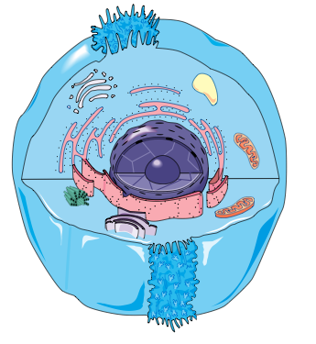
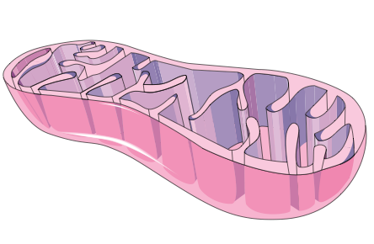
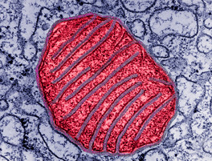
Cellular Respiration
Typical animal cell
Cellular respiration is a catabolic, energy-yielding pathway.
  It is the process by which organisms break down energy rich molecules, such as glucose, releasing energy for the synthesis of ATP.
  Aerobic respiration requires oxygen.
  Forms of cellular respiration that
  do not require oxygen are said to
  be anaerobic.
Cell cytosol
Inner membrane
Outer membrane
Mitochondrion
Mitochondrion (false colored) taken by TEM.
Magnification x 14,000

Slide 11
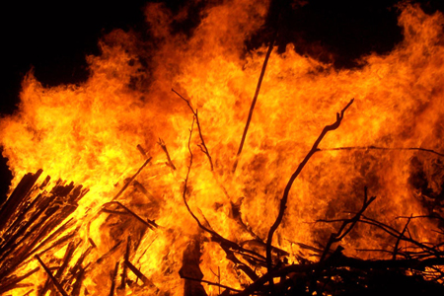
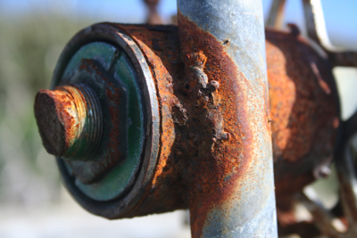
Redox Reactions
As well as using ATP, cells can transfer energy through the transfer of electrons in what are called oxidation-reduction reactions.
  Oxidation is the chemical process in which
  a substance loses electrons.
  Reduction is the chemical process in which a substance gains electrons.
  Because oxidation and reduction reactions occur simulatenously, they are called
  redox reactions.
  In cells, redox reactions usually involve transfer of a hydrogen atom rather than just an electron.
In cellular respiration, redox reactions release the energy stored in food
moleules so that ATP can synthesized
using that energy.
In a fire (combustion), fuels are oxidized rapidly to produce water and carbon dioxide.
Rusting is another familiar example of a redox reaction. When iron rusts, the iron (II) loses electrons to form iron(III) oxide.

Slide 12
A Summary of
Aerobic Respiration
Glycolysis
Glycolysis
Location: cytoplasm
Process: Glucose is broken down into two molecules of pyruvate.
Cell cytoplasm
Transition Reaction
Transition reaction
Location: mitochondrial matrix
Process: Formation of acetyl coenzyme A from pyruvate.
Krebs Cycle
Krebs cycle
Location: mitochondrial matrix
Process: A series of reactions producing carbon dioxide, ATP and hydrogens.
Mitochondrion
Electron transport chain
Location: mitochondrial cristae
Process: H2 is oxidised to water using oxygen. Energy is released as ATP.
Electron transport chain

Slide 13
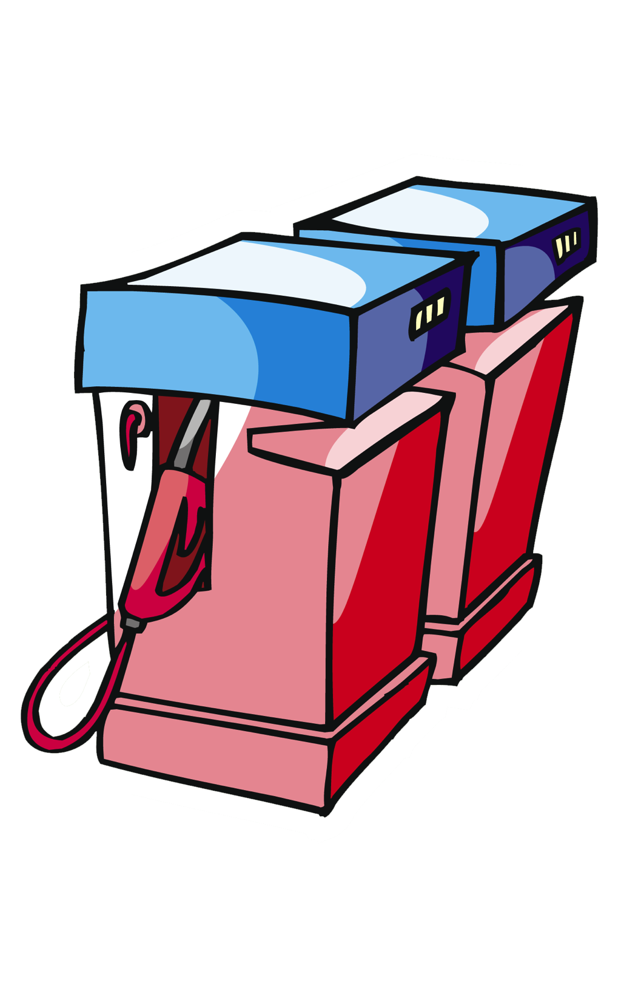

Cellular Respiration
Cellular respiration can be simplified by comparing it with the combustion reaction required to power a car.
CAR
Fuel
+ oxygen
Carbon dioxide,
water, kinetic energy
CAR
CELL
Food
+ oxygen
Carbon dioxide,
water.
energy (ATP)
CELL
 | Car | Cell
Fuel | Petrol, diesel, or gas | Glucose* and other carbohydrates, fat, protein
Oxidizer | Oxygen | Oxygen
Location | Engine | Cell cytoplasm and mitochondria
Exhaust products | Carbon dioxide water | Carbon dioxide, water, Energy (ATP)
*Glucose is the major fuel source for cellular respiration

Slide 14
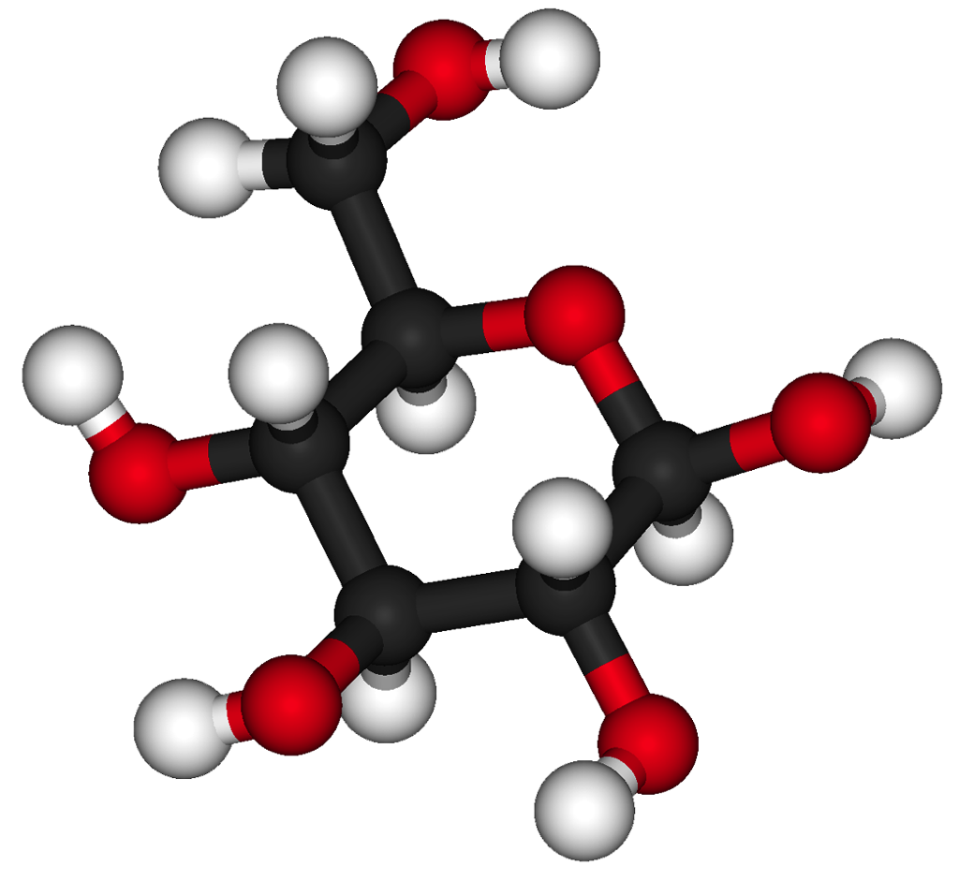
Glucose Metabolism
The breakdown of glucose and other organic fuels (such as fats and proteins) to simpler molecules is exergonic.
  It releases energy for the synthesis of the high energy molecule, ATP.
Glycolysis begins glucose metabolism in all cells. It occurs in the cytoplasm.
Aerobic respiration uses oxygen from the environment to completely convert the products of glycolysis to carbon dioxide through a set of metabolic pathways. These reactions take place in:
  the mitochondrial matrix (Krebs cycle)
  the inner membranes of the mitochondrion (electron transfer chain and oxidative phosphorylation)
Glycolysis
Krebs Cycle
Electron transport chain

Slide 15
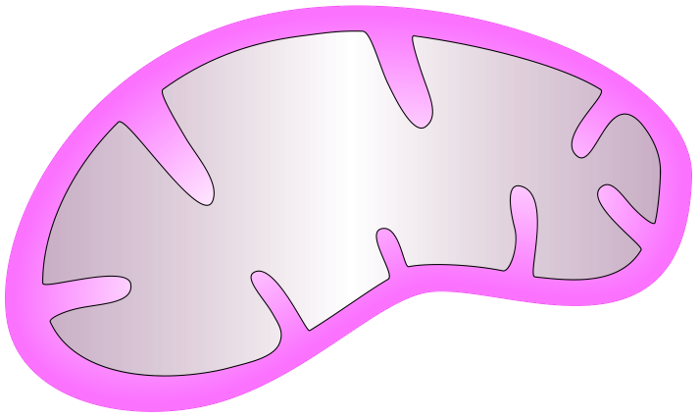
Cellular Respiration
Electrons carried via NADH
Electrons carried by NADH and FADH2
Cristae
Mitochondrial matrix
GLYCOLYSIS
The cytoplasm
Glucose ➙Pyruvate
KREBS CYCLE
Matrix of the mitochondria
ELECTRON TRANSPORT CHAIN AND OXIDATIVE PHOSPHORYLATION
The inner membrane of the mitochondria
Mitochondrion
ATP
ATP
ATP
Substrate-level phosphorylation
Substrate-level phosphorylation
Oxidative phosphorylation

Slide 16
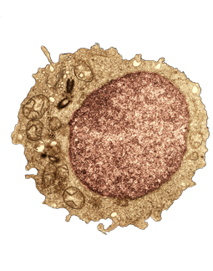
Glycolysis
Cytosol
Glycolysis comes from Greek words meaning sugar splitting.
Glycolysis is the first step of cellular respiration. It converts glucose
into pyruvate.
It occurs in the cell cytosol.
Glycolysis has three main functions:
  Production of cellular energy sources
  (ATP and NADH) for anaerobic and
  aerobic respiration.
  Production of pyruvate for use in the citric acid cycle.
  The production of intermediate carbon compounds, which can be removed for other cellular purposes.
This TEM image is of a human lymphocyte cell taken from bone marrow tissue. The cytosol is clearly visible around the large central nucleus.
Magnification X 25 710.

Slide 17
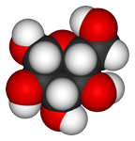
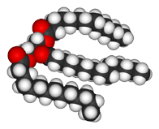
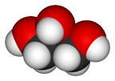
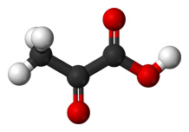
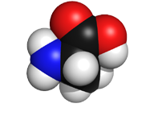
Substrates for Glycolysis
Glucose is the main fuel for glycolysis. Glycogen can also be used as a feed substrate, but must first be converted into glucose.
Other substrates also enter the glycolytic pathway at later phases. These include:
  fats, which are converted into glycerol.
  proteins (as amino acids).
Glycogen
Glucose
Glycolysis
Pyruvate
Fats
Glycerol
Triglyceride
Proteins
Alanine
Amino
acids

Slide 18
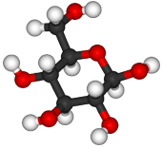
The Glycolysis Process
During glycolysis, one glucose molecule (6 carbon sugar) is converted into two pyruvate (3 carbon acid) molecules.
Several intermediate products are produced, which may be utilized at any time in other cellular processes.
1 x glucose (6C)
Phosphate
1 x phosphorylated
6C sugar
2 x 3C sugar phosphate
(glyceraldehyde-3-phosphate)
2 x pyruvate

Slide 19
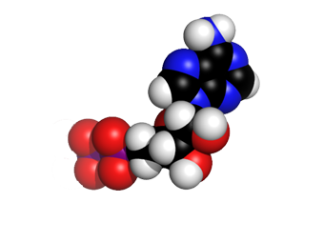
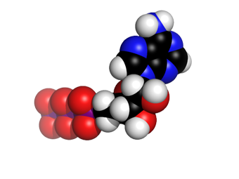
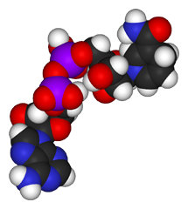
Glycolysis Yield
For every glucose molecule, glycolysis yields:
  2 ATP net
  2 NADH + 2H⁺
  2 pyruvate
  molecules
Glucose
2 ADP + 2Pi
1 x glucose (6C)
4 ATP are produced but 2 ATP are consumed
1 x phosphorylated
6C sugar
2 ATP
2 x 3C sugar phosphate
(glyceraldehyde-3-phosphate)
2 x pyruvate
Pyruvate
2 NADH + H⁺

Slide 20
Glycolysis in Review
The diagram below gives an overview of glycolysis.
The key inputs, outputs and intermediate molecules are given.
2 ADP + 2Pi
Glycogen
1 x glucose (6C)
Glycerol
1 x phosphorylated
6C sugar
Fats
2 ATP
2 x 3C sugar phosphate
(glyceraldehyde-3-phosphate)
Proteins
Amino acids
2 x pyruvate
2 NADH + H⁺

Slide 21
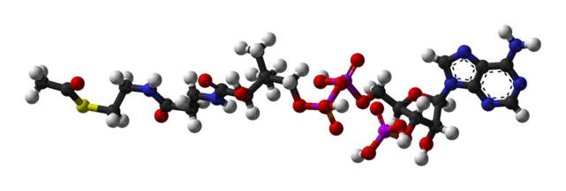
Transition Reaction
Pyruvate
A transition reaction is required to link glycolysis to the Krebs cycle.
In the transition reaction, the pyruvate molecules produced as the end product of glycolysis are converted to acetyl coenzyme A.
  This occurs in the matrix
  of the mitochondrion.
  During the reaction a carbon is removed as carbon dioxide.
Coenzyme A (CoA) picks up the remaining 2-carbon fragment of the pyruvate to form
acetyl coenzyme A (right).
Pyruvate
1C (as CO2)
NADH + H⁺
Acetyl Coenzyme A
Acetyl coenzyme A

Slide 22
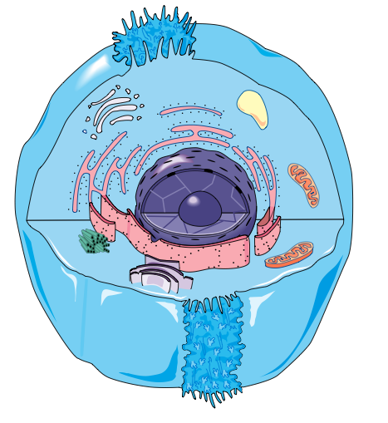
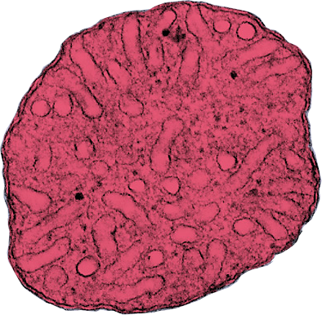
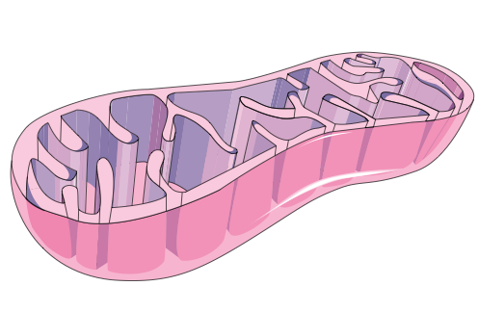
The Krebs Cycle
The Krebs cycle (or citric acid cycle) is the second step in the process of cellular respiration.
The Krebs cycle occurs in the matrix of the mitochondria.
The mitochondrial matrix is where pyruvate is transformed into acetyl coenzyme A.
This TEM cross section through a single mitochondrion shows the folded inner membrane and the matrix (arrowed).

Slide 23
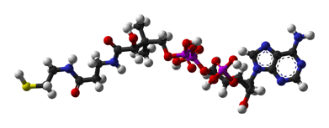
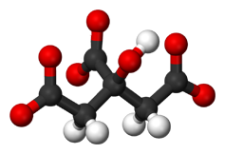

The Krebs Cycle
Acetyl coenzyme A
Acetyl Coenzyme A
Acetyl group
Acetyl coenzyme A is the feed molecule for the Krebs cycle.
Acetyl CoA is split releasing the
2-carbon acetyl group. Coenzyme A is formed.
The acetyl compound combines with oxaloacetate (a 4 carbon compound) to form citrate (a
6 carbon compound).
Oxaloacetate is regenerated via a number of steps as two carbon groups are subsequently lost as carbon dioxide.
CoA
Acetyl
(2 carbons)
Coenzyme A
Oxaloacetate
(4 carbons)
Citrate
(6 carbons)
2 carbons
(as CO2)
Carbon dioxide
Citrate

Slide 24
The Krebs Cycle Yield
Two turns are required to completely oxidize one glucose molecule.
Two turns of the Krebs cycle yields:
  4 CO2
  2 ATP
  6 NADH + H⁺
  2 FADH2
The Krebs cycle yields a small amount of energy in the form of ATP, but a lot of potential energy in the form of reducing power in NADH and FADH.
The energy value from the Krebs cycle is realized when the NADH and FADH2 molecules (which act as electron carriers) are used to generate ATP in the next stage of glucose metabolism.
Acetyl Coenzyme A
CoA
Acetyl
(2 carbons)
Oxaloacetate
(4 carbons)
Citrate
(6 carbons)
2 carbons
(as CO2)
1 ATP
3 NADH
1 FADH2
This diagram represents one turn of the Krebs cycle. Actual yields are doubled as two turns are required to oxidize glucose completely.

Slide 25
Electron Transport Chain
The electron transport chain (ETC) is the final stage in cellular respiration.
The electron transport chain is a series of hydrogen and electron carriers, located on the membranes of the mitochondrial cristae.
This final stage involves oxidative phosphorylation and ATP generation.
This TEM cross section through a single mitochondrion shows the outer membrane and the inner cristae (arrowed)

Slide 26
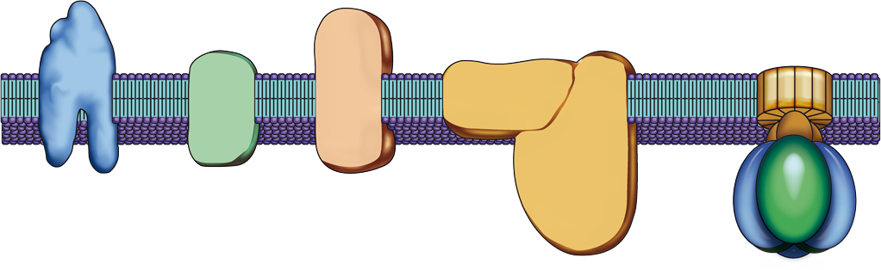
Electron Transport Chain
The electron transport chain consists of many linked proteins embedded in the cristae.
These proteins are electron carriers and alternately reduced and oxidized as they accept and donate electrons.
NADH-Q reductase
Cytochrome C reductase
Inter-membrane space
Ubiquinone
Cristae membrane
Cytochrome C
Cytochrome C oxidase
Mitochondrial matrix

Slide 27


Electron Transport Chain
Electrons from glycolysis and the Krebs cycle are transported to the electron transport chain as NADH and FADH2. The hydrogens or electrons donated from NADH and FADH2 are passed from one carrier protein to the next.
  Oxygen is the final electron acceptor in the chain, and it is reduced to water.
The electron transport chain yields 34 ATP and water.
H⁺
H⁺
Inter-membrane space High H⁺ concentration
H⁺
H⁺
H⁺
H⁺
H⁺
H⁺
H⁺
e⁻
e⁻
e⁻
NADH + H⁺
NAD⁺
FADH2
FAD
e⁻
H2O
(water)
H⁺
Mitochondrial matrix
Low H⁺ concentration
H⁺
H⁺
2H + ½O2 (oxygen)

Slide 28
Chemiosmosis
The energy released from the electrons is used to transport hydrogen ions (H⁺) across the membrane. This results in the establishment of a proton gradient.
The proton gradient couples the electron transport to ATP synthesis by a process called chemiosmosis.
Chemiosmosis takes place in the inter-membrane space of the mitochondria and is the process where electron transport is coupled to ATP synthesis.
The inter-membrane space is the site of chemiosmosis in the mitochondrion.

Slide 29
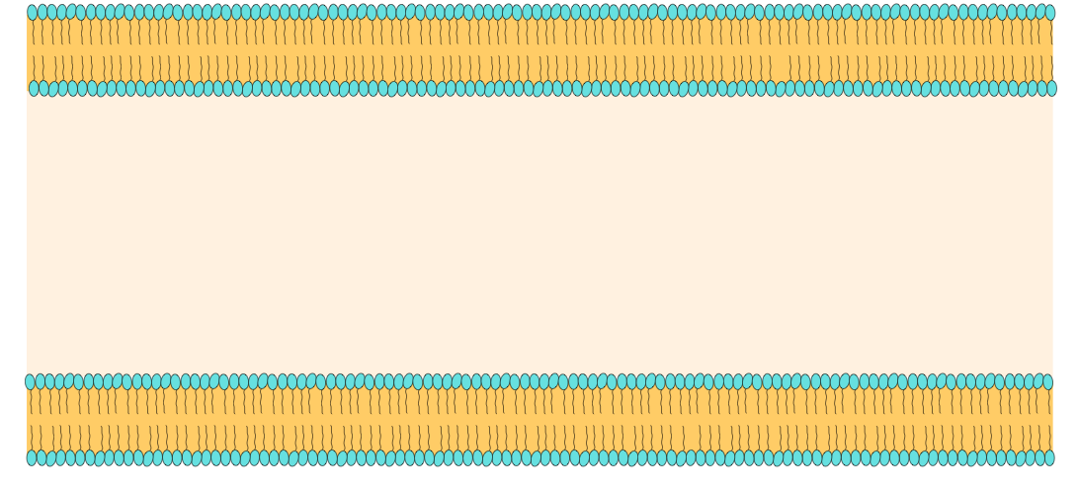

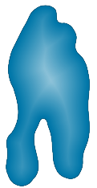
Chemiosmosis
Energy from the oxidation of NADH + H⁺ and FADH2 (in the electron transport chain) is used to move protons against their concentration gradient (from a low H⁺ concentration to a high H⁺ concentration).
The protons move from the mitochondrial matrix into the inter-membrane space between the two membranes.
Outer mitochondrial membrane
Inter-membrane space
High H⁺ concentration
H⁺
H⁺
H⁺
H⁺
H⁺
H⁺
H⁺
H⁺
H⁺
H⁺
H⁺
Carrier protein
H⁺
H⁺
Mitochondrial matrix
Low H⁺ concentration
Inner mitochondrial membrane
H⁺

Slide 30
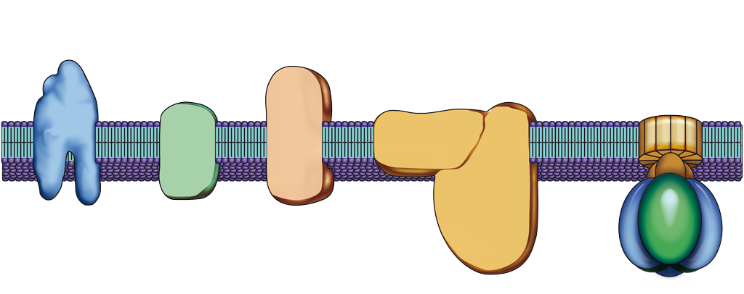
Chemiosmosis
The protons flow back down their concentration gradient via an enzyme called ATP synthase. This molecule uses the energy released from the H⁺ flow to produce ATP.
This coupling of H⁺ production to ATP production is shown below.
H⁺
H⁺
H⁺
Inter-membrane space High H⁺ concentration
H⁺
H⁺
H⁺
H⁺
H⁺
H⁺
H⁺
H⁺
H⁺
H⁺
H⁺
Cytochrome C reductase
NADH-Q reductase
e⁻
e⁻
e⁻
Ubiquinone
Cytochrome C
Cytochrome C oxidase
ATP synthase
NADH + H⁺
NAD⁺
FADH2
FAD
e⁻
H⁺
H⁺
H⁺
H2O
ADP + Pi
Mitochondrial matrix
Low H⁺ concentration
ATP
2H + ½O2
H⁺

Slide 31
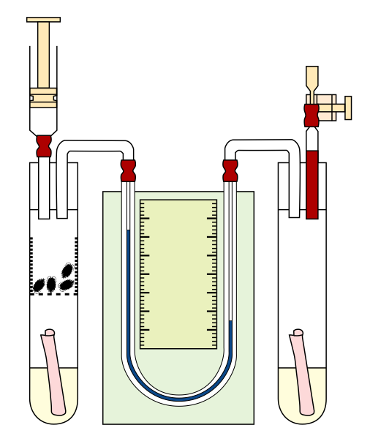
Respiration Quotient
Tap (closed during experiment)
In small animals or germinating seeds, the rate of cellular respiration can be measured using a simple respirometer.
  A respirometer is a sealed unit.
  Carbon dioxide (CO2) produced by the respiring tissues is absorbed by soda lime.
  The volume of oxygen consumed is detected by fluid displacement in a manometer.
Syringe
Manometer containing colored liquid
Calibrated scale
Filter paper
In this simple respirometer, small invertebrates are contained in a perforated gauze basket and the volume of oxygen consumed is measured by fluid displacement in the manometer.
Perforated gauze basket
Soda lime solution (absorbs CO2)
Soda lime solution (absorbs CO2)

Slide 32
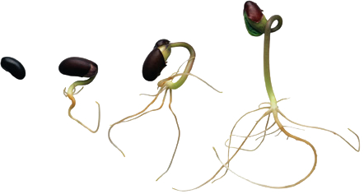
Respiratory Quotient
The respiration quotient (RQ) can be used as an indication of the primary fuel source for cellular respiration and metabolism, for example, fat or carbohydrate.
The respiratory quotient (RQ) is the simple ratio of the amount of CO2 produced during cellular respiration to the amount of oxygen consumed:
Different substrates produce typical RQ values
when respired (table right):
  The oxidation of pure carbohydrate
  produces an RQ of 1.0.
  Organisms usually respire a mix of substrates
  (RQ values of 0.8-0.9).
CO2 produced
 | RQ | Substrate
 |  |  | More oxygen required for oxidation
 | >1.0 | Carbohydrate with some anaerobic metabolism
 | 1.0 | Carbohydrates, e.g. glucose
 | 0.9 | Protein
 | 0.7 | Fat
 | 0.5 | Fat with associated carbohydrate synthesis
 | 0.3 | Carbohydrate with associated organic acid synthesis
RQs are lower in substrates requiring more oxygen for their complete oxidation
RQ =
O2 consumed
Germinating seeds typically respire a mix of fats and carbohydrates

Slide 33



Measuring Respiration
The graph below shows RQ values obtained from respirometer experiments of germinating wheat seeds (Triticum sativum). The RQ values reveal the substrates utilized for respiration.
  Low RQ values in early germination indicate fat is being utilized.
  RQ values of closer to 1.0 in later stages of germination indicate carbohydrate is the primary fuel source.
Fat is the primary respiratory substrate during early germination
Modified after Clegg and MacKean 1994
Later in germination, carbohydrates are the primary fuel for respiration

Slide 34

Anaerobic Pathways
All organisms can metabolize glucose anaerobically (without oxygen) using glycolysis in the cytoplasm.
Fermentation pathways for glucose metabolism do not use oxygen as a final electron acceptor.
The energy yield from fermentation is low, and few organisms can obtain sufficient energy for their needs this way.
An alternative electron acceptor is required in the absence of oxygen, or glycolysis will stop.
  In alcoholic fermentation the electron acceptor is ethanal.
  During lactic acid fermentation the electron acceptor is pyruvate itself and the end product is lactic acid.
Alan Wheals, University of Bath
Alcoholic fermentation in yeast, (Saccharomyces cerevisiae), is the basis of the brewing and baking industries.
Fermentation is distinct from anaerobic respiration. Respiration always involves hydrogen ions passing down a chain of carriers to a terminal acceptor and this does not happen in fermentation. In anaerobic respiration, the terminal H⁺ acceptor is a molecule other than oxygen, e.g. Fe²⁺ or nitrate.

Slide 35

Lactic Acid Fermentation
Glycolysis can continue in the absence of oxygen by reducing pyruvate to lactic acid.
This process is called lactic acid fermentation.
Lactic acid is toxic and this pathway cannot continue indefinitely.
  The liver converts the lactic acid back into a harmless respiratory intermediate.
  Lactic acid fermentation occurs in
  the skeletal muscle of mammals.
Glucose
C6H12O6
2 ADP
2 ATP
Net
NAD.H2
2 x pyruvate
CH3COCOOH
Lactic Acid Fermentation
Animal tissues
Lactic acid
CH3CHOHCOOH
Pyruvate
waste product
NAD.H2
NAD⁺
Skeletal muscle

Slide 36
Alcoholic Fermentation
Yeasts respire aerobically when oxygen is available but can use alcoholic fermentation when it is not.
Such organisms are called facultative anaerobes.
At ethanol levels above 12-15%, fermentation is toxic to the yeast cells. Alcoholic fermentation cannot be used indefinitely.
The root cells of plants also use fermentation as a pathway when oxygen is unavailable.
As ethanol is toxic, it must be
converted back to respiratory
intermediates and respired
aerobically to reduce its levels.
Glucose
C6H12O6
2 ADP
2 ATP
Net
NAD.H2
2 x pyruvate
CH3COCOOH
Alcoholic Fermentation
Yeast, higher plant cells
Ethanal
CH3CHO
+ CO2
Ethanol
CH3CH2OH
gaseous waste product
NAD.H2
NAD⁺

Slide 37


Alcoholic Fermentation
Alcoholic fermentation is carried out by yeasts and some types of bacteria.
The by-products of alcoholic fermentation (ethanol and carbon dioxide) form the basis of the brewing and baking industries.
Bread (above) rises during baking as a
result of the carbon dioxide given off during alcoholic fermentation.
Alcoholic beverages such as beer (left), derive their alcohol content from the ethanol produced from alcoholic fermentation.

Slide 38


Facultative Anaerobic Metabolism
Facultative anaerobic metabolism occurs when organisms or tissues can produce ATP using aerobic respiratory pathways when oxygen is present, and anaerobic pathways if oxygen is absent.
Examples of facultative anaerobes include the bacteria Listeria and Salmonella, and some yeasts, e.g. Saccharomyces.
Vertebrate skeletal muscle is facultatively anaerobic because it has the ability to generate ATP for a short time in the absence of oxygen (e.g. during sprints).
Athletics NZ
During short, hard muscular efforts, human muscle performs anaerobically.
CDC
Salmonella is a facultative anaerobe

Slide 39


Obligate Anaerobes
Some organisms respire only in the absence of oxygen; oxygen is toxic to them. Such organisms are called obligate anaerobes.
Some are bacterial pathogens and the by-products of their metabolism are highly toxic and cause diseases such as tetanus, gangrene (right), and botulism.
Obligate anaerobes generate ATP using various fermentative pathways or anaerobic respiration in which the terminal electron acceptor is a molecule other than oxygen.
CDC
The bacterium Yesinia pestis (left), causes bubonic plague. Gangrene (seen in the hand above) is a common manifestation of the plague.
CDC

Slide 40



Aerobic & Anaerobic Pathways Compared
 | Aerobic Respiration | Anaerobic Pathways
 |  | Alcoholic fermentation | Lactic acid fermentation
H⁺ acceptor | Oxygen | Ethanal | Pyruvate
Products | CO2 + water | Ethanol + CO2 | Lactic acid
Phosphorylation type | Substrate level and oxidative | Substrate level | Substrate level
Comments | Most energy is produced during the Krebs cycle | Toxic when ethanol levels are >12-15% | Lactic acid is toxic and must be removed

Slide 41

Photosynthesis
Photosynthesis is the action of transforming sunlight energy into chemical energy. Photosynthesis produces:
  energy for use by the autotroph and for use later down the food chain.
  oxygen gas, essential for the survival of advanced life forms.
Water and nutrients
(via the roots)
Sugar
(to rest of the plant)
Sunlight
Carbon dioxide gas
(through stomata)
Oxygen gas
(through stomata)
6CO2 + 12H2O
Light
C6H12O6 = 6O2 + 6H2O
Chlorophyll

Slide 42
A Summary of Photosynthesis
A basic overview of photosynthesis is presented in the diagram below.
Water
Carbon
dioxide
Raw materials
ADP
Light Dependent Phase
Process: Energy Capture via Photosystems I and II
Location: Grana
Light Independent Phase
Process: Carbon fixation via the Calvin cycle
Location: Stroma
ATP
Main product
Glucose
Solar
energy
NADP.H2
NADP
Oxygen
Water
By-products

Slide 43


Photosynthesis
Photosynthesis is carried out by plants, algae, some bacteria and some protists.
In plants and photosynthetic protists, photosynthesis takes place in membrane-bound organelles called chloroplasts.
  Chloroplasts are filled with a green pigment called chlorophyll. This is what gives plants their green coloring.
In photosynthetic bacteria, the reactions of photosynthesis take place within the
cell itself, not within a discrete organelle.
A plant mesophyll cell with a chloroplast highlighted.
Plant chloroplast.
TEM X37,000

Slide 44

The Electromagnetic Spectrum
Light is a form of energy known as electromagnetic radiation.
The segment of the electromagnetic spectrum most important to life is the narrow band between about 380 and 750 nanometres (nm).
  This radiation is known as visible light because it is detected as colors by the human eye.
  Visible light drives photosynthesis.
Gamma rays
x-rays
Ultra violet
Infrared
Microwave
Radio waves
Visible light
380
400
450
550
650
750
Increasing energy
Increasing wavelength
Wavelength (nm)

Slide 45


Pigments & Light Absorption
Light striking an object it is either reflected, transmitted or absorbed.
Substances that absorb visible light are called pigments.
The ability of a pigment to absorb particular wavelengths of
light can be measured with a spectrophotometer (below).
The light absorption vs the wavelength is called the absorption spectrum of that pigment.

Slide 46


Photosynthetic Pigments
The photosynthetic pigments of plants fall into two categories:
  Chlorophylls, which absorb red and blue-violet light. They are the main photosynthetic pigment in plants and give leaves their green color (below).
  Carotenoids, which absorb strongly in the blue-violet and appear orange, yellow, or red. They are considered to be associate pigments. Carotenoids give carrots their orange color (right).

Slide 47


Photosynthetic Pigments
The photosynthetic pigments of the chloroplasts in higher plants absorb blue and red light, and the leaves therefore appear green (which is reflected).
Plant leaves also contain accessory pigments, which capture light outside the wavelengths captured by chlorophyll.
Sunlight energy
Green light is reflected
Red and blue light is absorbed
Thylakoid discs

Slide 48


Photosynthetic Pigments
Each photosynthetic pigment has its own characteristic absorption spectrum.
Although only chlorophyll a can participate directly in the light reactions of photosynthesis, the accessory pigments (chlorophyll b and carotenoids) can absorb wavelengths of light that chlorophyll a cannot.
The accessory pigments pass the energy (photons) to chlorophyll a, thus broadening the spectrum that can effectively drive photosynthesis.
Space filling model of the chlorophyll a molecule (left). Chlorophyll has a porphyrin ring with a magnesium atom in its centre and a hydrocarbon tail. Chlorophyll a is responsible for the green coloration of plant leaves (right).
Porphyrin ring
Hydrocarbon tail

Slide 49
Absorption spectrum
The absorption spectrum of different photosynthetic pigments provides clues to their role in photosynthesis, since light can only perform work if it is absorbed.
Absorption spectra of photosynthetic pigments
(Relative amounts of light absorbed at different wavelengths)
80
Chlorophyll b
60
Carotenoids
Percentage absorbance
40
Chlorophyll a
20
0
400
500
600
700
Wavelength (nm)

Slide 50
Action Spectrum
An action spectrum profiles the effectiveness of different wavelength light in fueling photosynthesis. It is obtained by plotting wavelength against some measure of photosynthetic rate (e.g. CO2 production).
100
Action spectrum for photosynthesis
(Effectiveness of different wavelengths in fueling photosynthesis)
80
60
Rate of photosynthesis (as percent of rate at 670 nm)
40
20
The action spectrum closely matches the absorption spectrum for the photosynthetic pigments.
0
400
500
Wavelength (nm)
600
700

Slide 51
The Chloroplast
The chloroplast is enclosed by an envelope consisting of two membranes separated by a very narrow intermembrane space.
Membranes also divide the interior of the chloroplast
into compartments:
  flattened sacs called thylakoids, which in places are stacked into structures called grana.
  the stroma (fluid) outside
  the thylakoids.
They contain DNA and also ribosomes, which are used to synthesize some of the proteins within the chloroplast.
Thylakoid membranes
Grana, are stacks of thylakoid membranes containing chlorophyll
Stroma, the liquid interior of the chloroplast
Inner membrane
Thylakoid sac (disc)
Outer membrane

Slide 52

The Biochemistry of Photosynthesis
Sunlight
CO2
H2O
Photosynthesis is, in many ways, the reverse process of respiration. The same principles of electron carriers, electron transfer, and ATP generation through chemiosmosis apply.
  Water is split and electrons are transferred
  together with hydrogen ions from water to CO2.
  The CO2 is reduced to sugar.
  Sugar, oxygen and water are produced
  as by-products.
  The electrons increase in potential energy
  as they move from water to sugar. The
  energy to do this is provided by light.
Photosynthesis can be summarized as the
following chemical reaction:
6CO2 + 12H2O + light energy ➙ Glucose (C6H12O6) + 6O2 + 6H2O
O2
Sugars are produced during photosynthesis and utilized by the plant.
H2O

Slide 53

Photosynthesis
There are two phases in photosynthesis:
  The light dependent phase
  (D), which occurs in the thylakoid membranes of a chloroplast.
  The light independent phase
  (I), which occurs in the stroma
  of chloroplasts.
D
I
D
Diagrammatic representation(top) and false colored electron micrograph (left) of a plant chloroplast showing the sites of the light dependent and light independent phases of photosynthesis.
I

Slide 54
Photosynthesis in C3 Plants
The diagram below summarizes photosynthesis in a C3 plant.
Water from the cell sap
is used as a raw material
Sunlight
ATP
NADPH + H⁺
Oxygen gas (from the break up of water molecules) is given off as a waste product.
Water is given off as a waste product.
Hydrogen (from the break up of water molecules) is used as a raw material.
Carbon dioxide from the air provides carbon and oxygen as raw materials. Carbon is fixed in the Light independent phase
triose phosphate
(a 3-carbon sugar)

Slide 55




Conversion of Triose Phosphate
Cellulose
Triose phosphate, produced during photosynthesis, is the base product leading to the formation of many other molecules. It is converted to:
  Glucose, the fuel for cellular respiration; supplies energy
  for metabolism.
  Cellulose, a component of plant cell walls is formed using glucose as a building block.
  Starch granules act as a reserve supply of energy, to be converted back into glucose when required.
  Disaccharides. Glucose is converted to other sugars
  such as fructose, found in ripe fruit, and sucrose, found
  in sugar cane.
  Lipids and amino acids.
Starch granule
Sucrose
Lysine, an amino acid

Slide 56
Photosystems
The photosystems in green plants are protein complexes used to harvest light energy so it can be converted into chemical energy (ATP and NADPH) in the thylakoids of the chloroplasts
The photosystems are associated with the light dependent phase of photosynthesis.
They absorb light energy and elevate electrons to a higher energy level.
Primary
acceptor
Protein complex
Protein complex
Primary
acceptor
Light
NADPH
Light
ATP
A summary of noncyclic electron flow through the two photosystems of the light dependent phase.
P700
P680
Photosystem I
Absorbs light at 700nm
Photosystem II
Absorbs light at 680 nm
Electrons lost are replaced by electrons from PSII
Photosystem II. Light energy is absorbed by chlorophyll to elevate electrons to a moderate energy level. They have an optimal wavelength of 680 nm.
Photosystem I. Light energy is absorbed to elevate the electrons to an even higher level. Its electrons are replaced by electrons from photosystem II. They have an optimal wavelength of 700 nm.

Slide 57






Light Dependent Phase
When chlorophyll molecules absorb light, an electron is excited to a higher level. This electron is replaced to photosystem II in one of two ways:
  In non-cyclic phosphorylation (below), the electrons lost to the electron transport chain are replaced by splitting a water molecule.
  In cyclic phosphorylation electrons lost from photosystem II are replaced by those from photosystem I. ATP is generated but not NADPH.
Light energy
NADP⁺ + 2H⁺
Light energy
NADPH + H⁺
2e⁻
2e⁻
2e⁻
2e⁻
Photosystem II
Photosystem I
H⁺
NADP⁺ reductase
½O2
2H⁺
H2O
Thylakoid space
ADP + Pi
ATP synthase
ATP
Thylakoid membrane
H⁺

Slide 58
Light Dependent Phase
Electron transport chain: Each electron is passed from one electron carrier to another; losing energy as it goes. This energy is used to pump hydrogen ions across the thylakoid membrane.
NADP is a hydrogen carrier picking up H⁺ from the thylakoid and transporting them to the Calvin cycle.
When chlorophyll molecules absorb light, an electron is excited to a higher level. This electron “hole” must be filled.
Light energy
NADP⁺ + 2H⁺
Light energy
NADPH + H⁺
2e⁻
2e⁻
2e⁻
2e⁻
Photosystem II
Photosystem I
H⁺
NADP⁺ reductase
½O2
2H⁺
Flow of H⁺ back across the membrane is coupled to ATP synthesis by chemiosmosis.
H2O
ADP + Pi
Photolysis of water: In non-cyclic phosphorylation, the electrons lost to the electron transport chain are replaced by splitting a water molecule (photolysis) releasing oxygen gas and hydrogen ions.
ATP
H⁺
ATP synthase catalyzes the production of ATP from ADP and inorganic phosphate (Pi)

Slide 59
Light Independent Phase
CO2
The light independent phase or Calvin cycle (carbon fixation) occurs in the stroma of the chloroplast.
In the Calvin cycle, carbon
atoms from CO2 are incorporated into existing organic molecules.
  Hydrogen (H⁺) is added to CO2 and a five carbon intermediate molecule to make carbohydrate.
  The reducing power for carbon fixation is supplied by NADPH.
  The enzyme involved, RuBisCo, works optimally in low oxygen environments.
Ribulose bisphosphate carboxylase (RuBisCo)
RuBP: Ribulose bisphosphate
G3P: Glycerate 3-phosphate
ADP + Pi
ATP
NADPH + H⁺
ATP
ADP + Pi
Ribulose phosphate
NADP
Triose phosphate
The carbohydrates produced during the Calvin cycle can be stored to provide energy for use at a later stage. Carbon fixation does not occur only in darkness but was named because it does not require light to proceed. The H+ and ATP are supplied by the light dependent phase.
Hexose sugars

Slide 60

Factors Affecting Photosynthetic Rate
The rate at which plants can make food (the photosynthetic rate) is dependent on environmental factors. Some factors have a greater effect than others. These include:
  the amount of light available.
  the level of carbon dioxide (CO2).
  the temperature.

Slide 61

Factors Affecting Photosynthetic Rate
Light intensity vs photosynthetic rate
The effect of light intensity on photosynthetic rate is shown in this experiment using cucumber plants.
The experiment was carried out at a constant temperature and constant carbon dioxide level.
The rate of photosynthesis increases exponentially with light intensity until a maximum rate is achieved. At this point increasing the light intensity has no effect on photosynthetic rate and the rate of photosynthesis reaches a plateau.
90
80
70
Rate of photosynthesis (mm³CO2 cm⁻²h⁻¹)
60
50
40
1
2
3
4
5
6
7
Units of light intensity (arbitrary scale)

Slide 62
Factors Affecting Photosynthetic Rate
This graph shows how temperature and CO2 levels affect photosynthetic rate in cucumber plants.
Photosynthetic rate increases as
the CO2 concentration increases. At high concentrations, the rate of photosynthesis begins to slow as limiting factors other than CO2 become important.
An increase in temperature increases photosynthetic rate because of its effect on enzyme activity. However, temperatures exceeding the optimum will eventually decrease photosynthetic rates because of the detrimental effects of heat on enzyme structure.
Light intensity, CO2, and temperature vs photosynthetic rate
240
High CO2 at 30°C
200
High CO2 at 20°C
160
Rate of photosynthesis (mm³CO2 cm⁻²h⁻¹)
120
80
Low CO2 at 30°C
40
Low CO2 at 20°C
1
2
3
4
5
6
7
Units of light intensity (arbitrary scale)
Increasing the temperature when CO2 is limiting has little effect on photosynthetic rate.

Slide 63



Photosynthesis in C4 Plants
In many plants, the first detectable compound made during photosynthesis is a 3-carbon compound called glycerate 3-phosphate (3GP). Plants that produce 3GP are termed C3 plants.
In some plants, oxaloacetate, a
4-carbon molecule, is the first compound to be made. Plants that produce this compound are termed C4 plants.
C4 plants include the tropical monocots important as food crops:
  Sugar cane (Saccharum officinarum)
  Maize (Zea mays)
  Sorghum (Sorghum bicolor)
Sugar cane
Maize
Sorghum

Slide 64


Photosynthesis in C4 Plants
C4 plants are capable of
high rates of photosynthesis
in high temperature-high
light environments.
C4 plants have a high yield of photosynthetic products compared to C3 plants, giving them a competitive advantage in tropical environments.
This characteristic is also an advantage for commercial crop plants such as maize and sugar cane.
C4 plants thrive in hot, humid tropical conditions such as those found in Hawaii (top right) and Fiji (bottom right).

Slide 65

Photosynthesis in C4 Plants
C4 plants have chloroplasts in both the mesophyll and the bundle sheath cells.
They increase photosynthetic rates by separating Rubisco from atmospheric oxygen, fixing carbon as 4-carbon intermediates in the mesophyll cells and using these to ferry the fixed carbon to Rubisco in the bundle-sheath cells.
Upper epidermis
Bundle sheath
VB
Spongy mesophyll
Palisade mesophyll
Lower epidermis
This C4 leaf cross section shows the chloroplasts within the cells of the bundle sheath and the palisade mesophyll. Tightly packed mesophyll cells keep oxygen away from the bundle sheath cells, which surround the vascular bundle (VB).
Stoma (CO2) entry
Chloroplasts

Slide 66

Photosynthesis in C4 Plants
CO2
A low oxygen environment is essential for the enzyme ribulose bisphosphate carboxylase (Rubisco) to function optimally in the Calvin cycle. By protecting RuBisCo from oxygen, C4 plants achieve high photosynthetic rates.
Oxaloacetate
C4
1
Hatch and Slack pathway
Photosynthesis in the palisade mesophyll cells captures light energy in the chloroplasts and fixes CO2 (as a 4C intermediate) in the cytoplasm. C4 plants can fix large quantities of CO2 because the enzyme PEP carboxylase has a high affinity for CO2 and can incorporate it into the 3C compound phophoenol pyruvate (PEP) at low levels.
PEP
PEP carboxylase
C3
Hatch-Slack pathway
Malate
C4
Pyruvate
C3
2
Calvin cycle (bundle sheath)
Malate is transfered from the palisade cells to the inner bundle sheath where it is broken down to pyruvate. CO2 is released for use in the Calvin cycle.
+ CO2
Calvin cycle

Slide 67


Slide 68
Terms of Use
Biozone International retains copyright to the intellectual property included in this presentation file, with acknowledgement that certain photos are used under license and are credited appropriately on the next screen.
You MAY:
  Use these slides for presentations in your classrooms using a data projector, interactive whiteboard, and overhead projector.
  Place these files on the school’s intranet (school computer network), but not in contradiction of clause 3 (a) below.
  Edit and customize this file by adding, deleting, and modifying information to better suit your needs.
  Place these presentation files on any computer within the school, including staff laptops.
  Print out this file in PowerPoint “Handouts” format as per the print dialogue box, for the express purpose of allowing students to make their own notes about the presentation.
You MAY NOT:
  Put these presentation files onto the internet or on a service that may be accessed offsite from the campus, unless access to the service is protected by a user login and password protocol.
  Print these files onto paper to make your own worksheets for distribution to students.
  Create a NEW document using any of the graphics/images in this presentation file.
  Incorporate any part of this presentation file for the production of another commercial product.
  REMOVE any of the references to Biozone, the copyright notices, photo credits, or terms of use from this file.

Slide 69
Photo Credits
Images Used Under Licence
Photographic images are used under licence from the following photo libraries:
  Corel Corporation Professional Photos
  (various titles, including: Science & Medicine, Agriculture).
  ArtToday.com
  Clipart.com
  PhotoDisc Inc.
  Hemera Technologies Inc.
  PhotoObjects.com
  Visuals Unlimited
  iStock
  Education Interactive Imaging
Images Used with Permission
Photographic images used with permission from the copyright holder:
Alan Wheales University of Bath
Athletics New Zealand
Images from the Public Domain
Images from the public domain include copyright expired, uncopyrighted, or uncopyrightable material:
CDC Public Health Image Library (PHIL)
NASA
Additional artwork and photographs are the property of Biozone International Ltd.
BIOZONE International Ltd | P.O. Box 13-034, 109 Cambridge Road, Hamilton, NEW ZEALAND
Phone: + 64 7 856-8104 | Fax: + 64 7 856-9243 | E-mail: sales@biozone.co.nz | Internet: www.biozone.co.nz
Copyright © 2007 Biozone International Ltd
All rights reserved

Slide 70






Presentation MEDIA
Our current range includes:
See full details on our web site:
www.thebiozone.com/media.html

